Slide 1
1. Acids and Bases Intro
GE002

Slide 2
You need to be able to….
Define what acids and bases are.
List the properties of acids and bases.

Slide 3
What do we already know?

Slide 4
What do we already know?
ACIDS
BASES

Slide 5
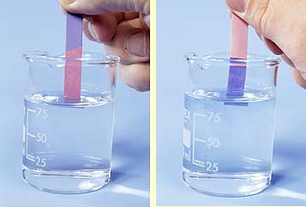
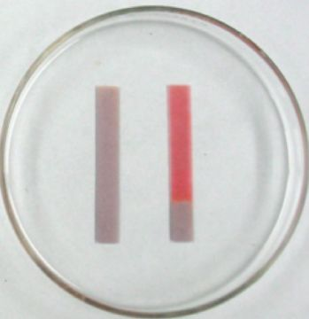
Properties of acids and bases
Litmus paper:
Acid turns it red
Base turns it blue

Slide 6

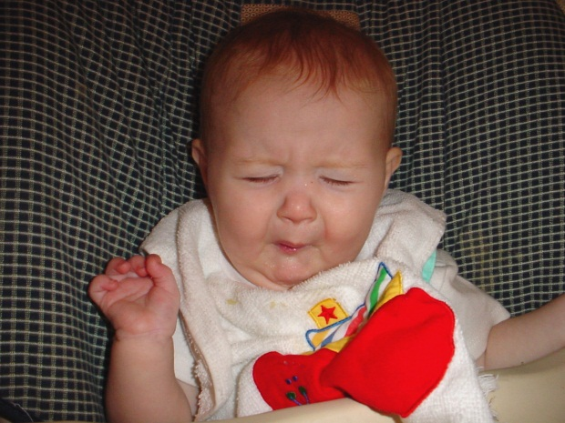

Taste and feel:
Base tastes bitter
Acid tastes sour
But would you touch or taste a solution you suspect to be an acid or a base?
NO!
Base is slippery

Slide 7
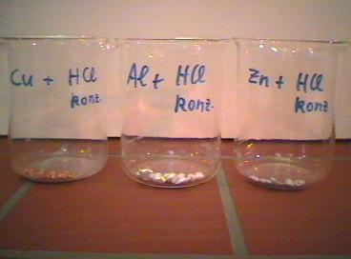
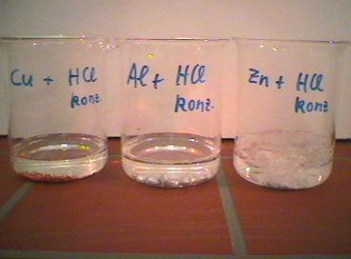
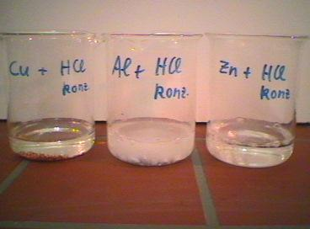
Chemical property of acids and bases
Metals and acids react to produce heat energy and hydrogen gas (bubbles).
Metals and bases react to produce hydrogen gas (bubbles).
Notes:
Coke cans in acids and bases
Explanation of pH, acids and bases.

Slide 8
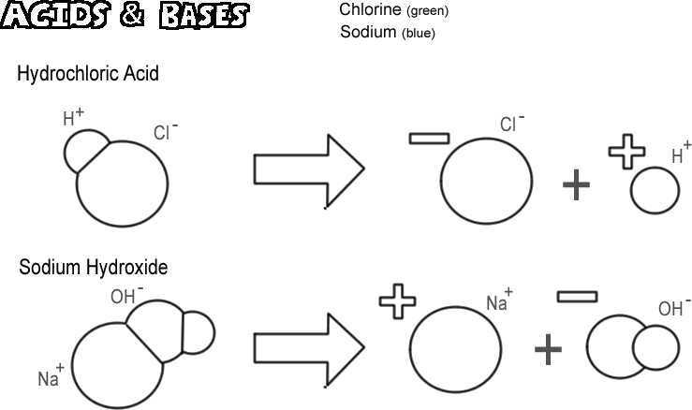
Chemical property of acids and bases:
They can neutralize each other!
H₂O (water)
NaCl (salt)

Slide 9
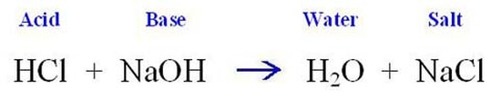
Neutralization Reaction!
neutral
neutral

Slide 10
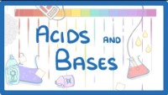

Slide 11
What are acids
Acids
Proton donors, they release H⁺ (positively charged hydrogen ions)
The more H⁺ released, the stronger the acid.
Corrosive
Neutralise bases
Taste sour
Low pH (1 to 6)

Slide 12
What is a base/alkali?
Bases
Proton acceptors, they accept H⁺
Alkalis release negatively charged hydroxide ions (OH⁻), making them good bases
The more OH⁻ released, the stronger the base/alkali.
Also corrosive
Neutralise acids
Tastes bitter, feel soapy or slippery
High pH (8 to 14)
An alkali is a base that can dissolve in water.

Slide 13
BAAD
Bases Accept, Acids Donate
H⁺

Slide 14
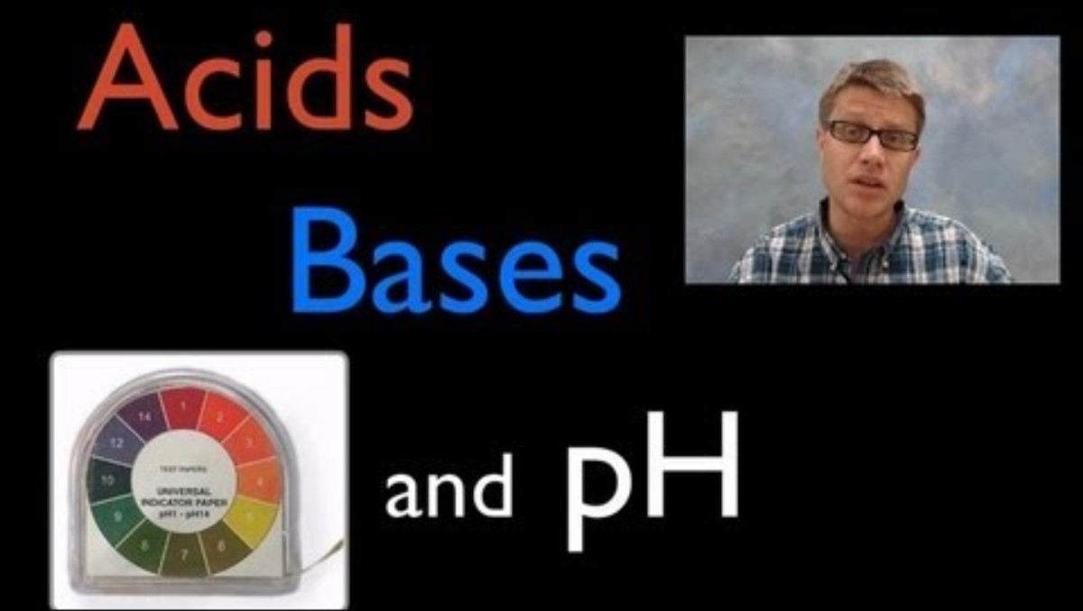

Slide 15
What is pH?
‘Power of hydrogen’
7 is neutral
1 to 7 is acidic
7 to 14 is basic
Each number on the scale is 10 times more acidic/basic than the previous number.

Slide 16
Give One Get One
Use the coloured sheet that you have been given to complete the corresponding section of the Give One Get One WS.
When instructed, find someone who has information that you don’t have then record their information on your sheet.
Take turns doing this.

Slide 17
Common Acids
HCl (hydrochloric acid) – This acid is used for cleaning brickwork. It is found in your stomach to digest food.
H₂SO₄ (sulfuric acid) – This acid is found in car batteries, used in the manufacture of fertilisers and detergents and also in old fire extinguishers.
HNO₃ (Nitric acid)- This acid is used in the production of explosives and for metal etching. When mixed with Hydrochloric acid (HCl) it can dissolve gold and platinum (one of the few chemicals that can do this).

Slide 18
Common Acids con’t.
CH₃COOH (ethanoic or acetic acid) - Found in vinegar. Useful solvent, descaling agent.
H₂CO₃ (carbonic acid) - Provides the fizz in soft drinks. Carbon dioxide is dissolved in drinks under high pressure. Makes a sour taste.
C₆H₈O₇ (Citric acid) – Mainly used in foods, found in citrus fruits.
C₃H₆O₃ (lactic acid) – Found in muscle cells at all times, but most prominent during strenuous exercise. Also found in dairy products (yoghurt etc).

Slide 19
Common Bases
NaOH (Sodium Hydroxide) – Used for soap manufacturing and as drain cleaner.
Mg(OH)₂ (Magnesium hydroxide) – Found in antacids and laxatives.
CaO (Calcium Oxide) – Used to make bricks, mortar and plaster.

Slide 20
Common Bases con’t.
Na₂CO₃ (Sodium Carbonate) – Used in washing powder and glass manufacturing.
NaHCO₃ (Sodium hydrogen carbonate – baking soda) – Makes cakes rise, deodorizes the fridge.
NH₃ (Ammonia) – Fertiliser production, cleaning agent and explosives.

Slide 21
Ions in acids and bases
Acids contain:
Hydrogen ions (H⁺).
Hydronium ions (H₃O⁺)
Bases generally contain:
Hydroxide ions (OH⁻)
Oxide ions (O²⁻)
Carbonate ions (CO₃²⁻)
Hydrogen carbonate ions (HCO₃⁻)

Slide 22
Definitions
Acid: a chemical substance that donates protons or hydrogen ions (H⁺) and/or accepts electrons.
E.g. Hydrochloric acid (HCl) , Sulfuric acid (H₂SO₄)
Base: a substance that releases Hydroxide ions (OH⁻) when dissolved in water. Some bases contain oxides, carbonates and hydrogen carbonates.
E.g. Sodium Hydroxide (NaOH)

Slide 23
Properties
Acids:
Corrosive (‘burns’ your skin)
Have a sour taste
Releases hydrogen ions (H+) when dissolved in water
Has a pH of less than 7
Turns blue litmus paper red.
Conducts electricity
Neutralized by bases
Bases:
Corrosive (‘burns’ your skin)
Have a soapy, slimy feel
pH of greater than 7
Turns red litmus paper blue
Have a bitter taste
Conduct electricity
Neutralized by acids

Slide 24
Strength
Acids:
The strength of the acid is determined by how many hydrogen ions (H⁺) are released.
Strong acids: Hydrochloric acid (HCl), Nitric acid (HNO₃)
Weak acids: Sulfurous acid (H₂SO₃), Nitrous acid (HNO₂)
Bases:
Strength is determined by how many hydroxide ions (OH⁻) are present.
Strong bases: Sodium Hydroxide (NaOH), Lithium Hydroxide (LiOH)
Weak bases: Ammonia (NH₃)

Slide 25
Alkalis
An alkali is a substance which produces hydroxide ions (OH⁻) when it is dissolved in water.
The hydroxide ions are what give the alkali the properties of a base.
Alkalis only behave as a base when they are dissolved in water.

Slide 26
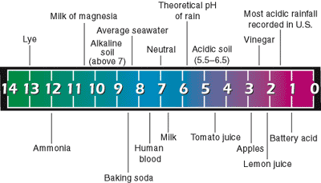
pH measures strength of acidity
Neutral is 7
Base is greater than 7
Acid is less than 7
H⁺ are very rare here!
pH 4 has 10x H⁺ as pH 5
Lots of H⁺ available up this end!
Notes:
Ask students where on this scale will I find the most hydrogen ions?

Slide 27

Chemical Reactions produce or release energy
One or more new substances
Energy is absorbed or released
reactant + reactant
product + product
If energy released EXOTHERMIC
If energy absorbed ENDOTHERMIC

Slide 28
How do Chemical Reactions Happen?

Slide 29
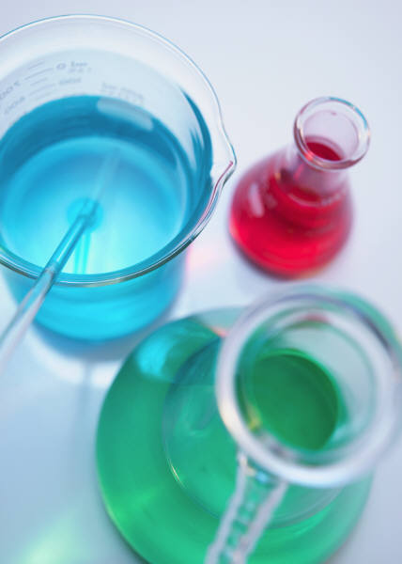
In Contact
Reactions don’t happen unless the substances are in contact.

Slide 30
Why?
The particles of the reactants need to get together so that they can react.

Slide 31
How does that work then?
Reactant particles
collide
REACTION
Product particles
formed

Slide 32
Is it really that simple?
Yes
Well, sort of.
not really.
OK, not quite!

Slide 33


Not all collisions are effective
Paper burns
Paper + oxygen → carbon dioxide + water + nitrogen
The paper in this room isn’t burning.
It doesn’t have enough energy to burn.
If we make it hotter it will catch fire.
Paper burns on its own at 250 ºC

Slide 34
A collision but with no effect
Reactant particles
collide
Product particles
not formed as there is not enough energy

Slide 35
Activation Energy
Reactions only happen if the particles have enough energy.
The minimum amount of energy needed to start a reaction is called the Activation Energy
All reactions have an activation energy, but this is different for each reaction.

Slide 36
More than the activation energy.
Reactant particles
collide
REACTION
Product particles
formed

Slide 37
More than the activation energy.
O
O
O
C
O
C
Effective collisions, a reaction.

Slide 38
The Collision Theory
Particles are constantly moving
For a chemical reaction to take place the reactant particles must collide first
For the collision to be effective the particles must have the right amount of energy
The minimum amount of energy required for an effective collision is called the activation energy

Slide 39
Factors affecting reaction rate
Concentration
Temperature
Catalysts
Surface Area

Slide 40
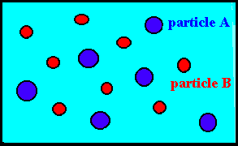
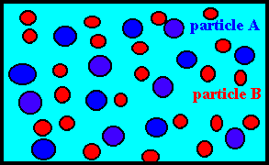
Concentration
More particles in the same space means more collisions.
More collisions means more effective collisions
If we double the concentration, we double the number of collisions

Slide 41
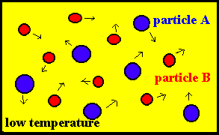
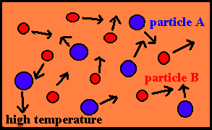
Temperature
Particles turn heat energy into kinetic energy
When they get hotter they move faster
When they move faster they collide more often
More collisions means more effective collisions

Slide 42
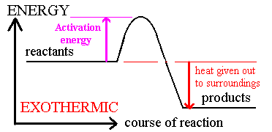
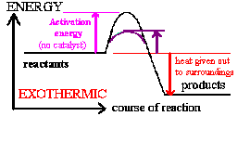
Catalysts
Activation energy
with a catalyst
Catalysts reduce the activation energy needed for a reaction
They do this by offering an alternate route for the reaction to take
Less activation energy means more effective collisions
More effective collisions means faster rate

Slide 43
Surface Area/Particle Size
Using smaller particles increases rate
Increase in surface area allows more collisions at surface
More collisions means more effective collisions means faster rate.

Slide 44
Look through your notes.
Give me one (new) fact about acids and bases.

Slide 45
HCl
Hydrochloric Acid

Slide 46
H₂SO₄
Sulfuric Acid

Slide 47
HNO₃
Nitric Acid

Slide 48
H₂CO₃
Carbonic Acid

Slide 49
CH₃COOH
Acetic Acid

Slide 50
NH₃
Ammonia

Slide 51
K₃O
Potassium Oxide

Slide 52
NaOH
Sodium Hydroxide

Slide 53
Ca(OH)₂
Calcium Hydroxide

Slide 54
CaCO₃
Calcium Carbonate

Slide 55
Are you now able to….
Define what acids and bases are?
List the properties of acids and bases?

